Slide 1
An exploratory review of participatory mapping tools
Automate your GIS course
Parissa Mokhtabad
Parissa@chalmers.se

Slide 2
Introduction to participatory mapping
Use and collection of geographical information among the various actors including public, citizens or non-experts (Bubalo et al., 2019).
Generally as participatory mapping (PM) (Brown et al., 2018), consist of citizen science (CS), volunteered geographic information (VGI), public participatory GIS (PPGIS), and smart cities initiatives
Enable kind of crowdsourcing or collaboration in making geographic information (Bubalo et al., 2019).
The aim of data-collection which corresponds with type of participation and
Highly varies in each of the initiatives, can range from being a mere hobby, conservation of natural resources, involvement in scientific projects, to reporting issues, decision-making and urban planning.
Issues of reliability of data and diversity of participants

Slide 3
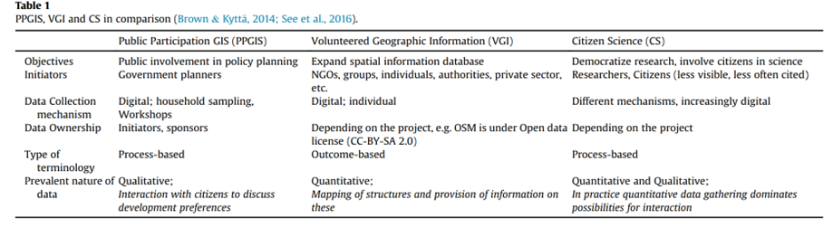
Comparison of VGI, PGIS and citizen science
(Brown et al., 2016)
Notes:
Hachmann, S., Arsanjani, J. J., & Vaz, E. (2018). Spatial data for slum upgrading: Volunteered Geographic Information and the role of citizen science. Habitat international, 72, 18-26.

Slide 4
Review research method
This paper is part of my PhD project on environmental infrastructures which investigates how various actors interact with each other using digital tools.
This paper is primarily focused on an exploratory literature review to investigate use of digital tools (PGIS, PPGIS, VGI and citizen science) in environmental participation.
Initially, keywords of PGIS, PPGIS, VGI and citizen science were searched through two databases of web of science and Scopus. The results were of 50 most cited studies were then screened. Many of them did not involve technical aspects and were removed from this exploratory review. Next, in close reading of the texts, other references and tools (especially in GIThub) were found and traced.
Two case studies of Drinkable Rivers and ObstacEELS

Slide 5
Various Actors involved
Government and public agencies
Science institutions: interdisciplinary
Groups of public, NGOs
Private companies providing PM applications and softwares

Slide 6
Technical Aspects of PM
A simplified technical mechanism of PM tools enables adding GIS layers on map base layers.
Participants are asked to identify locations on a map based application programming interface (API) (Rall et al., 2019).
Enabled by advent of web 2.0 for online mapping (Bubalo et al., 2019).
Despite the commercialisation of the tools, an active community in Github exist which provide open-source scripts on VGI and PGIS for mapping spatial data from social medias, conveying VGI information from website to baselayers, etc.

Slide 7
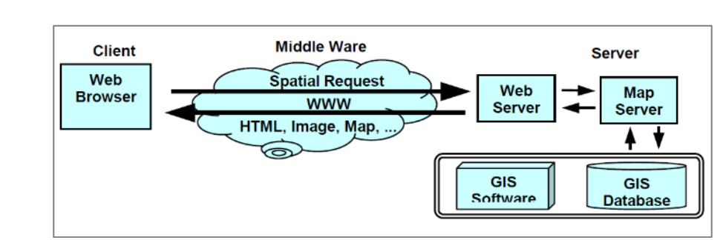
Typical WebGIS Model for application
Typical WebGIS Model for application
(Ali, 2021)

Slide 8
Types of participation
Passive and through gadgets and sensors
Choosing from preferences, uploading data.
Engaging in case of co-planning and decision-making tools

Slide 9
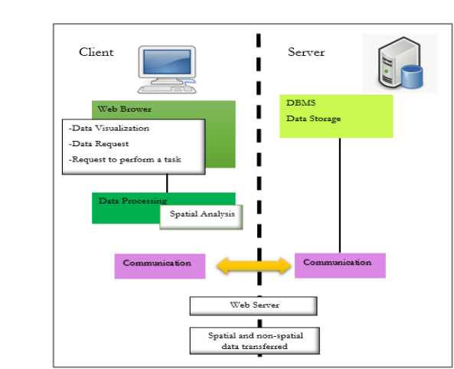
Typical WebGIS Model for application
Typical WebGIS Model for application
(Ali, 2021)

Slide 10
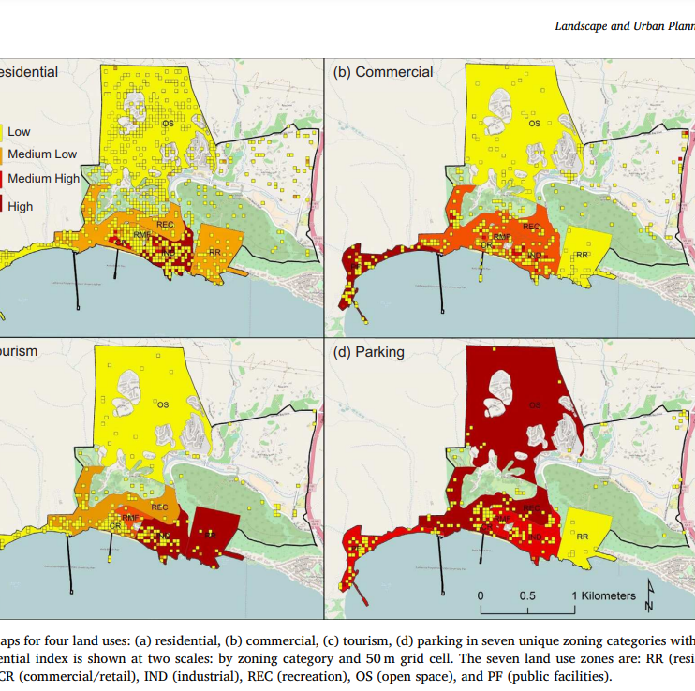
Case studies: showing preferences
Employs PM to convey information about land use and zoning.
Aims to inform citizen but citizens can show their preferences in the web survey
an internet based PGIS survey as a public participation tool which uses Google maps API.
Participant drag and drop icons representatives of land use and preferences into a map in form of URL website.
(Brown et al., 2018)

Slide 11
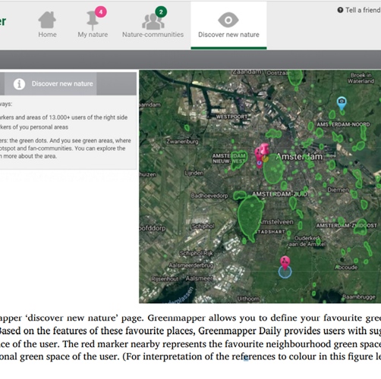
Case studies: showing preferences
Green mapper a web-based PM where participants show their favourite places
It uses OSM as its base layer
It is initiated by University of Groningen
(Bubalo et al., 2019)

Slide 12
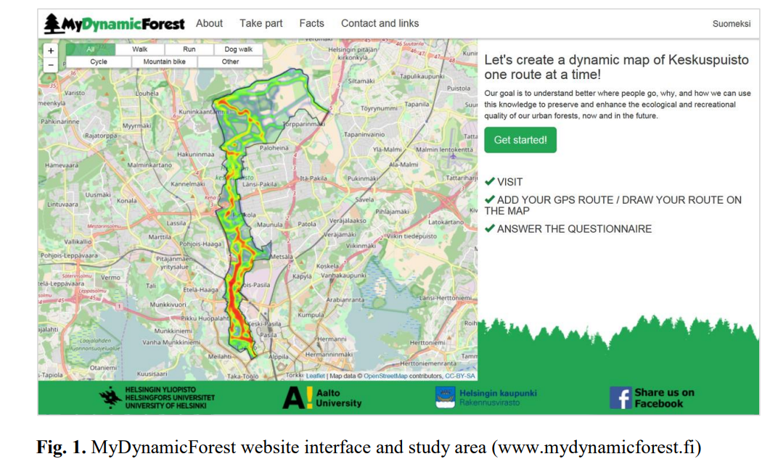
Case studies: showing preferences
Participants draw their routine map in OSM
It uses OSM as its base layer
(Korpilo et al., 2018)

Slide 13
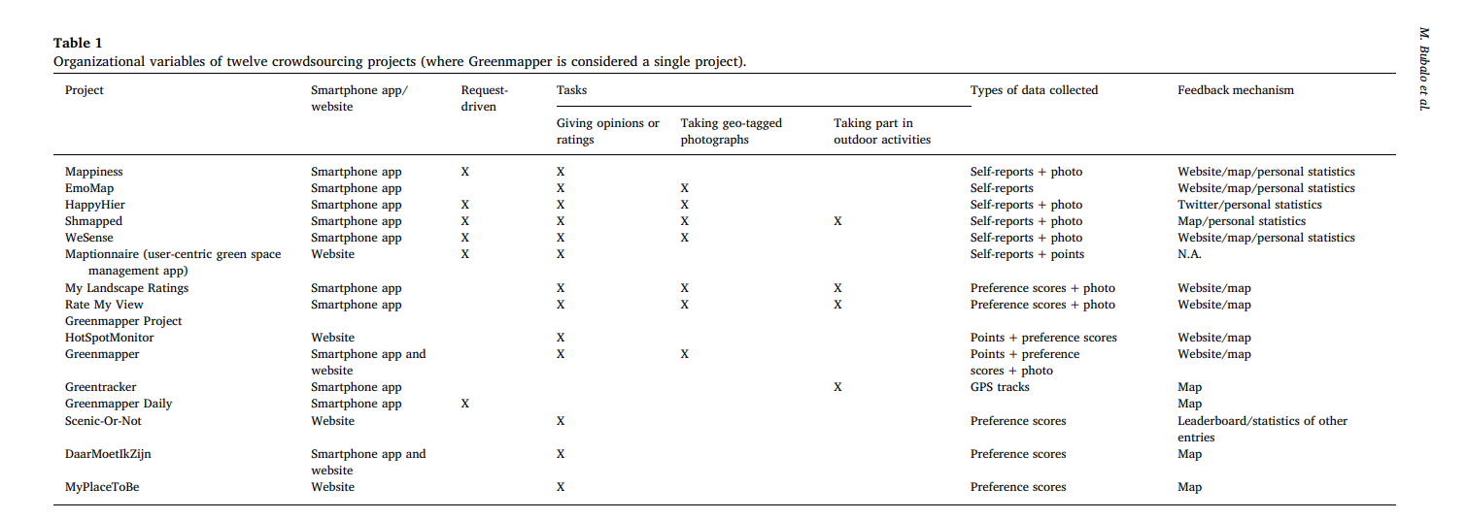
Other similar cases:
(Bubalo et al., 2019)

Slide 14
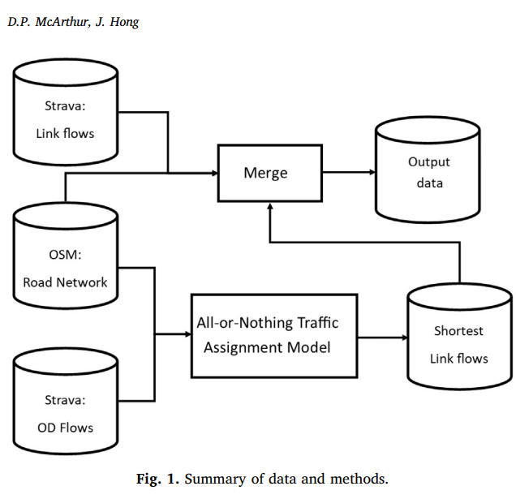
Using data with a mediator: cyclist tracking API
Utilizing data collected from the Strava activity tracking app in Scotland in 2016.
Open-source alternatives such as AequilibraE for Python could also be used.
(McArthur et al., 2019)

Slide 15
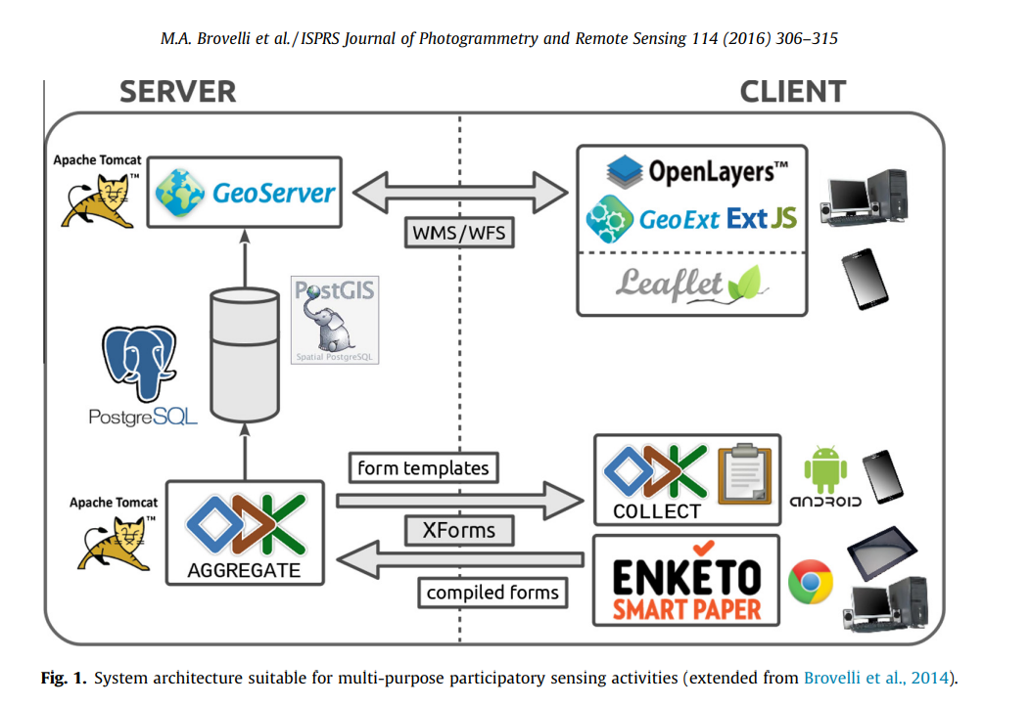
Public participation in GIS via mobile applications.
A modular system is designed to assist multi-purpose participatory sensing projects by enabling the management of geospatial data from the initial on-field collection up to the final Web publication. The system is entirely built with open source GIS technology
(Brovelli et al., 2016))

Slide 16
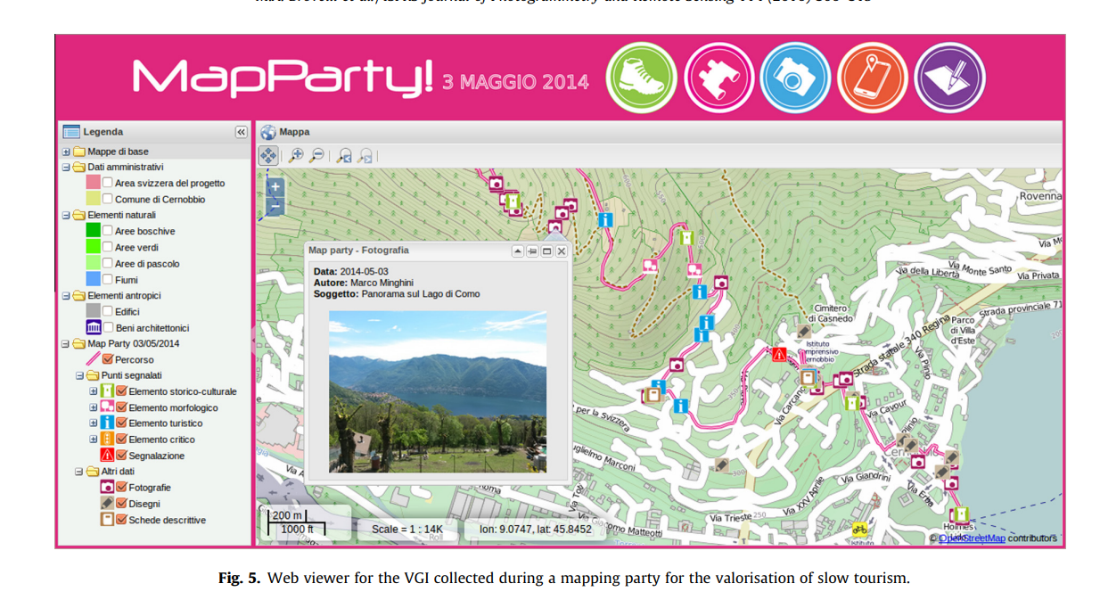
Public participation in GIS via mobile applications.
Data collection from mobile devices is achieved through the Open Data Kit (ODK) suite which is mainly composed of the ODK Collect and the ODK Aggregate modules. ODK Collect is a customizable mobile app for Android devices which, as mentioned in Section 2, allows collection of geospatial punctual data. It downloads form templates from, and sends user compiled forms to, ODK Aggregate, a Web application running under an Apache Tomcat server (http://tomcat.apache.org). ODK Aggregate manages forms and users (including their permissions on data access and download) and stores collected data through a synchronization with a PostgreSQL database (http://www.postgresql.org).
(Brovelli et al., 2016))
Notes:
collected VGI data can be only accessed by the same users of the app through a connection to the Aggregate server. Conversely, to make data available to the general public, the system utilizes the PostGIS spatial extension (http://postgis.net) to connect to the PostgreSQL database. This transforms user-generated contents into real geospatial data, allowing the GeoServer package (http://geoserver.org), also running under Apache Tomcat, to effectively read and publish it according to the OGC WMS (Web Map Service; Open Geospatial Consortium, 2006) and WFS (Web Feature Service; Open Geospatial Consortium, 2005) standard protocols
of freely accessible GIS Web viewers are then built (see for example, Figs. 2 and 5 below) to enable customized data access and interaction not only from traditional desktop computers, but also from mobile devices like tablets and smart phones. The former are achieved through the OpenLayers (http://openlayers.org), GeoExt (http://geoext.org), and ExtJS (http://www.sencha.com/ products/extjs) JavaScript libraries, the latter with the Leaflet (http://leafletjs.com) JavaScript library.
The proposed architecture makes full use of not only open source software, but also open standards. Besides the OGC WMS and WFS protocols mentioned above, the XForms standard from W3C (World Wide Web Consortium, 2009) is also exploited to manage and exchange data forms. XForms is an XML-based format designed to represent the next-generation of Web forms (Hartung et al., 2010) and providing a number of benefits when used on mobile devices (see http://en.wikipedia.org/wiki/XForms). Being based on open standards, the system has an interoperable, modular architecture where each component is closely linked to the others but at the same time stands on its own, allowing to be seamlessly replaced in case of need (e.g. if a new and better product were to appear on the market). As an example, the work of Brovelli et al. (2014) was further improved by replacing ODK Build with the more performing XLSForm (https://opendatakit. org/use/xlsform) for the creation of XForms-compliant forms for data collection.

Slide 17
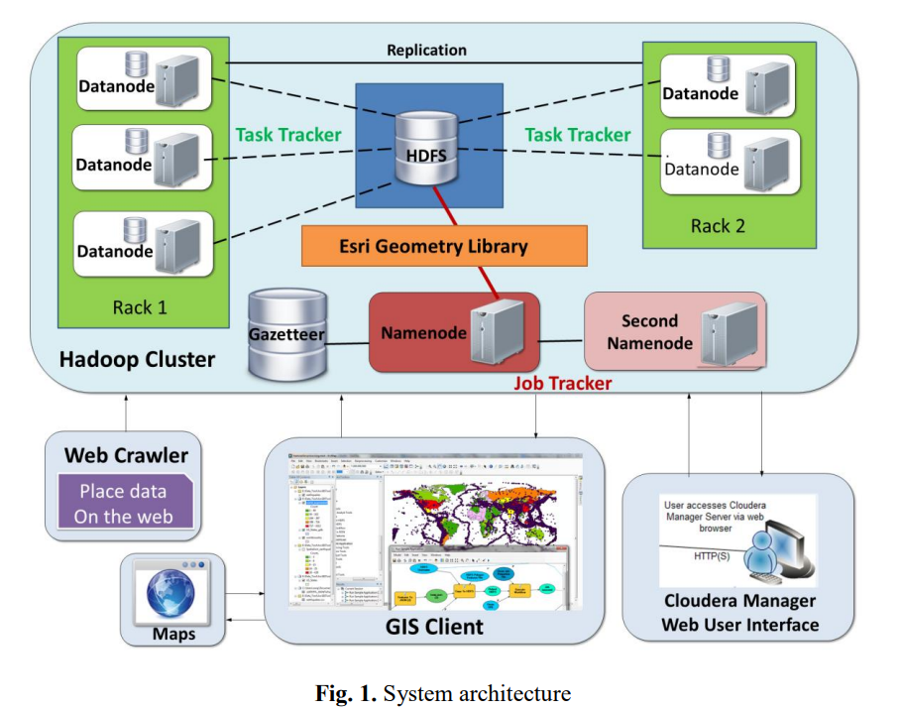
Using data with a mediator: cyclist tracking API
The Web crawler is a search engine written in Python to download place data from the Web and store them on the server
. Gao, S., Li, L., Li, W., Janowicz, K., & Zhang, Y. (2017). Constructing gazetteers from volunteered big geo-data based on Hadoop. Computers, Environment and Urban Systems, 61, 172-186.
(Li and others, 2017)

Slide 18
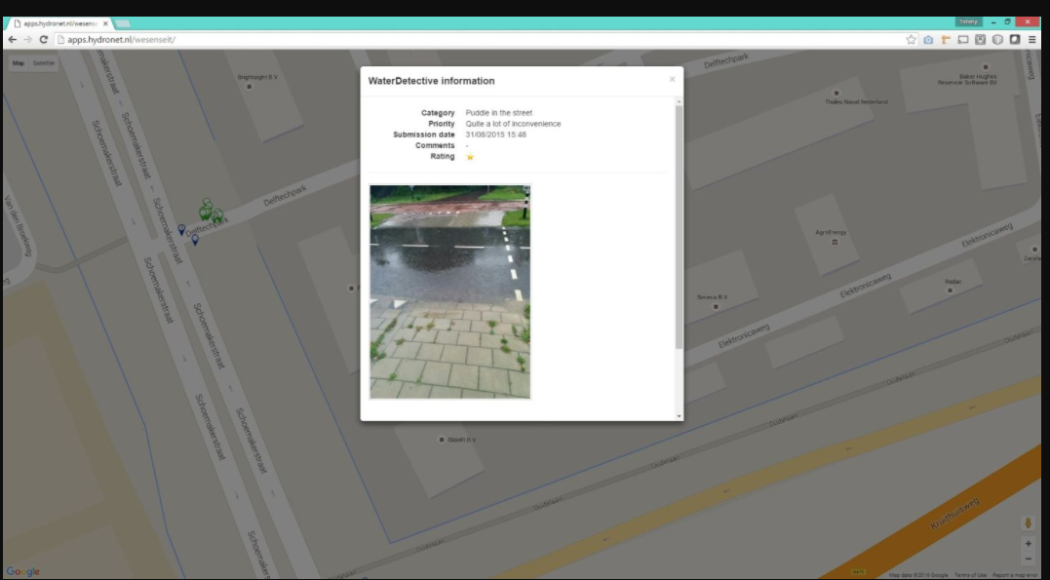
Geo tagging platform: WaterDetectors, One of the WeSenseit mobile applications
Citizen Science
Geotagging
https://www.wesenseit.com/projecten/waterdetective-web/
Notes:
Lanfranchi, V., Wrigley, S. N., Ireson, N., Wehn, U., & Ciravegna, F. (2014, January). Citizens' observatories for situation awareness in flooding. In ISCRAM 2014 Conference Proceedings-11th International Conference on Information Systems for Crisis Response and Management (pp. 145-154). Sheffield.

Slide 19
Geo tagging platform: Multi model observatory tool: WeSenseIt
WeSenseIt aims to develop a citizen-based observatory of water
Heterogenous nodes of data collection: either automatically monitored by citizens from their mobile devices or by direct messages to the authorities (with mobile-phone pictures, messages, etc.) and in terms of crowd-sourcing
Goal: two-way feedback and exchange of environmental knowledge/experience between citizens and authorities for decision-making and governance within an e-collaboration framework ,enabling improved transparency, knowledge management, accountability and responsiveness, as well as facilitating participation
Agencies in UK, NL and Italy.
Notes:
The applications seem patented https://www.wesenseit.com/applications/
Website for project: https://cordis.europa.eu/project/id/308429

Slide 20
ISPEX sensing gadgets and citizen engagement
iSPEX is an innovative way to measure aerosols. It needs an instrument which measures properties of small particles in the sky: aerosols.
Tools: Citizen Science, added measurement device
Goals: Citizen engagement, citizen awareness, data-collection
Used in: Leiden, Netherlands
Notes:
McCrory, G., Veeckman, C., & Claeys, L. (2017, November). Citizen science is in the air–Engagement mechanisms from technology-mediated citizen science projects addressing air pollution. In International Conference on Internet Science (pp. 28-38). Springer, Cham.

Slide 21

Citizen Science & Added sensing gadgets: ISPEX
Citizens register for the gadget
They measure the pollution with their devices
http://ispex.nl/en/ispex/introductie-ispex/
Notes:
McCrory, G., Veeckman, C., & Claeys, L. (2017, November). Citizen science is in the air–Engagement mechanisms from technology-mediated citizen science projects addressing air pollution. In International Conference on Internet Science (pp. 28-38). Springer, Cham.

Slide 22
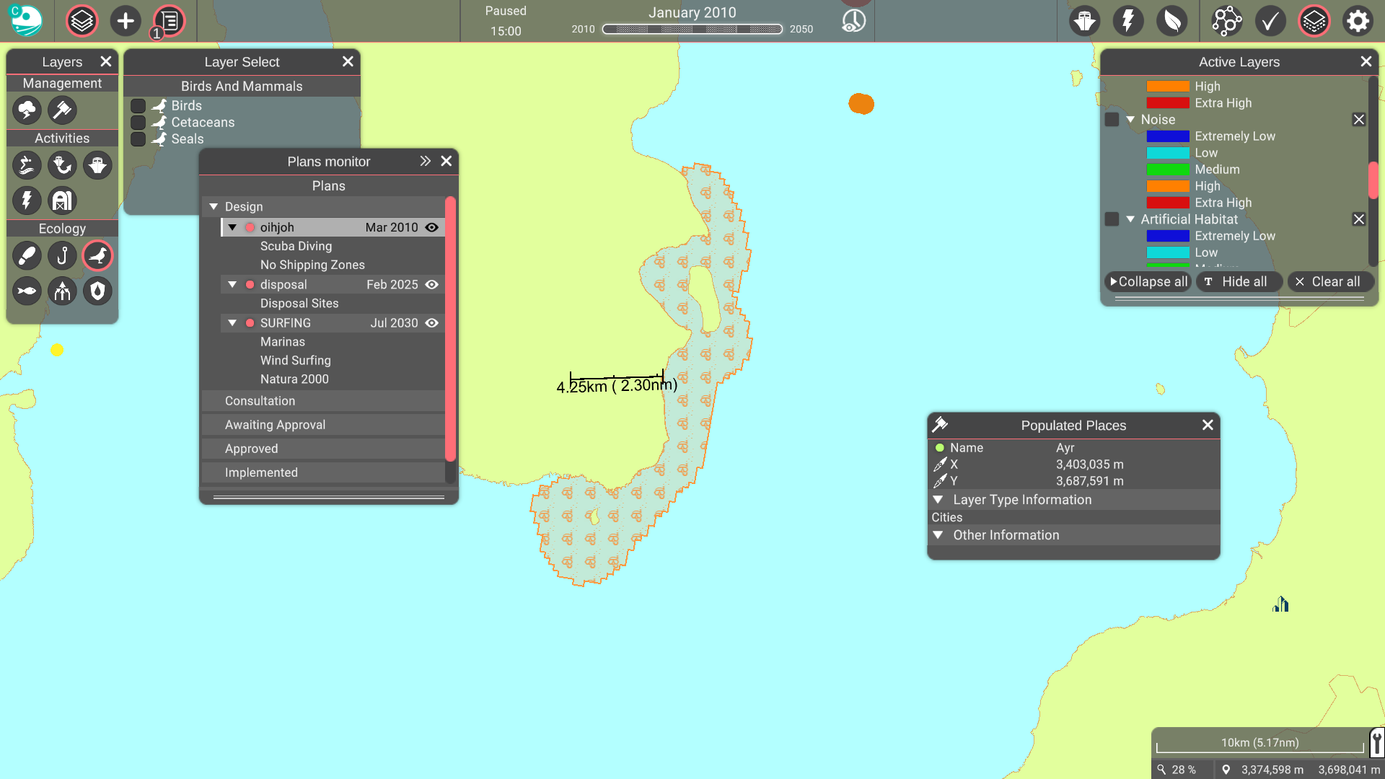
Simulation platform: MSP challenge

Slide 23
Simulation platform: MSP challenge
General:
Founders: Ministry for Infrastructure and Water Management of the Netherlands & Breda University of Applied science
Data providers: Multiple sources such as Nationaal georegister (NL), Marineregions.org, Rijkswaterstaat (NL), NLOG (NL), EMODnet, OSPAR ODIMS, Informatiehuis Marien, WUR, Copernicus, Natural Earth, LVNL. Full information
The platforms use open software and packages such as: DotSpatial.Projections.2.0.0-rc1 under MIT license, GeoJSON.Net.1.1.73 under MIT license, Newtonsoft.Json.10.0.2 under MIT license, Poly2Tri under a custom license conditionally allowing redistribution,
A user can select and deselect various visualized GIS layers such as ecology, pollution, wind, marine infrastructure, recreational places for marine areas.
A user can make a plan and add others to join. A plan has duration, and it gets rejected or accepted. As an example: I made natural reserve in some areas of North Sea: The error said there is cargo line there, so the plan was rejected.
Reservations and difficulties for a user:
Plans details, the procedure and choosing among various options are unclear and difficult for a user.
It is a nice visualization tool for communities to show a designed plan: it enables them to foresee grand problems, and the visualization translates the plan into data.
However, the platform can be customized, and enough explanations added.

Slide 24
Monetizing PM: from open-srouce to platformisation
Many components of PGIS are open source from base layers to code scripts which operationalise PM. (e.g. google map provide a service where users add layers to map and download the data)
Costs of maintenance, many of the projects initiated by universities, NGO or other parties fade away as the project funding finishes. >> commercialising
Public can not easily use open-source scripts and tools
Private companies, using open-source scripts provide PGIS customisable services to various actors (such as Maptionnaire, CitizenLab, Spotteron, Civocracy and Hive)

Slide 25
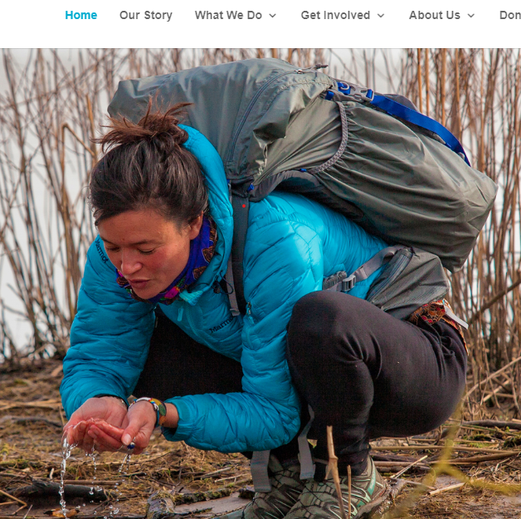
Case studies: Drinkable Rivers
Drinkable Rivers is a participatory mapping/citizen science initiative based in the Netherland,
Mixes using of gadget, community buildings and uploading VGI. The idea behind this project is that “drinkable river” should be a criterion for well-being of an environment; very tangible
This project involves various integral activities including river walks and action communities, measurements with toolkits and citizen science digital platform.
The platform of Drinkable Rivers is developed by Nucleoo which is a private company.
The collected data can be visualized by Drinkable Rivers data platform. It is up to hubs how they want to proceed with the data collected or how they want to be in touch with policy makers. One of the advantages of this platform is its focus on community building. The project builds network on various levels.

Slide 26
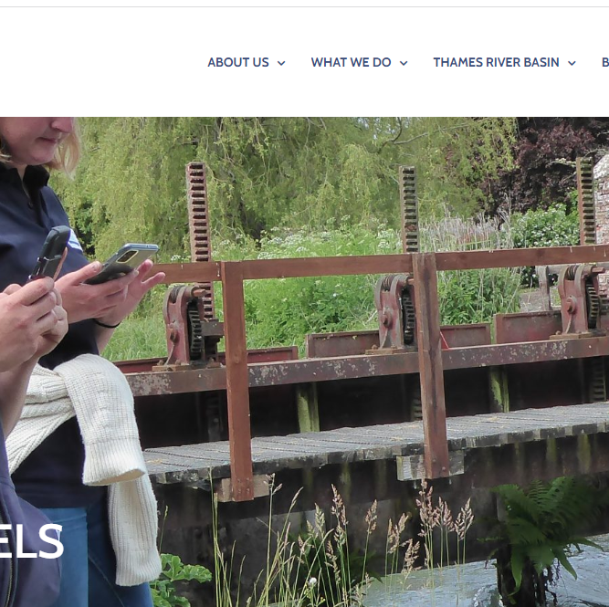
Case studies: ObstacEELS
ObstacEELS is a “citizen science initiative led by Zoological Society of London (ZSL) which has been collaboratively developed with four River Trusts
The project was inspired by fish migration road map and it was at the planning stage when applied for UK National Lottery Funding and received Green Recovery Challenge funding.
In ObstacEELS, near each of the five rivers , volunteers go in group for river walks and take photo and collect data of the barriers of fish passages (eel migration). In each of the project one can see a mixture of spatial data visualizations and photos of creative group activities to remove the barriers or assess the pollutions by volunteers which make the project unique.
The data in ObstacEELS platform comes from various sources which includes GIS layers, formal data and citizen scientist collected data.
Participants are trained to report, share and store data. The input from citizen scientists, after being deduplicated and cleaned by Obstaceels team, are uploaded in the platform.
The existing formal datasets underestimate the barriers of fish passages in the rivers: citizen scientist by going into the place, update and correct that data. The data from citizen scientists show 50% more barriers than the formal datasets.
Involving many NGOs and policy makers
ObstacEELS app is developed by Natural Aptitude. The app is mostly used by volunteers as a communication tool.

Slide 27
Discussion on findings
Actual usefulness: recruitment, community building
Successful cases use collective events for community building
Use of digital tools sometimes cause individual participation rather than collective
New roles: platform builders
Most projects do not last long: due to maintenance, funding, being project-based
Open-source tools though very valuable: public lack tools to access them

Slide 28
Thank you for your attention!
Parissa Mokhtabad
Parissa@chalmers.se

Slide 29
References
Ali, H., 2021. Web-based PPGIS application for participatory spatial planning in context of bikeability (Doctoral dissertation).
Bowker, G.C., Baker, K., Millerand, F. and Ribes, D., 2010. Toward information infrastructure studies: Ways of knowing in a networked environment. International handbook of internet research, pp.97-117.
Brovelli, M.A., Minghini, M. and Zamboni, G., 2016. Public participation in GIS via mobile applications. ISPRS Journal of Photogrammetry and Remote Sensing, 114, pp.306-315.
Brown, G., 2017. A review of sampling effects and response bias in internet participatory mapping (PPGIS/PGIS/VGI). Transactions in GIS, 21(1), pp.39-56.
Brown, G., Sanders, S. and Reed, P., 2018. Using public participatory mapping to inform general land use planning and zoning. Landscape and Urban Planning, 177, pp.64-74.
Bubalo, M., van Zanten, B.T. and Verburg, P.H., 2019. Crowdsourcing geo-information on landscape perceptions and preferences: A review. Landscape and urban planning, 184, pp.101-111.
Gao, S., Li, L., Li, W., Janowicz, K. and Zhang, Y., 2017. Constructing gazetteers from volunteered big geo-data based on Hadoop. Computers, Environment and Urban Systems, 61, pp.172-186.
Haklay, M. and Tobón, C., 2002. Usability Engineering and PPGIS-Towards a Learning-improving Cycle.
Korpilo, S., Virtanen, T., Saukkonen, T. and Lehvävirta, S., 2018. More than A to B: Understanding and managing visitor spatial behaviour in urban forests using public participation GIS. Journal of Environmental Management, 207, pp.124-133.
Landström, C., 2019. Environmental participation: Practices engaging the public with science and governance. Springer Nature.
Lanfranchi, V., Wrigley, S.N., Ireson, N., Wehn, U. and Ciravegna, F., 2014, January. Citizens' observatories for situation awareness in flooding. In ISCRAM 2014 Conference Proceedings-11th International Conference on Information Systems for Crisis Response and Management (pp. 145-154). Sheffield.
McArthur, D.P. and Hong, J., 2019. Visualising where commuting cyclists travel using crowdsourced data. Journal of transport geography, 74, pp.233-241.’
McCrory, G., Veeckman, C. and Claeys, L., 2017. Citizen science is in the air–Engagement mechanisms from technology-mediated citizen science projects addressing air pollution. In Internet Science: 4th International Conference, INSCI 2017, Thessaloniki, Greece, November 22-24, 2017, Proceedings 4 (pp. 28-38). Springer International Publishing.
Suman, A.B., Balestrini, M., Haklay, M. and Schade, S., 2023. When Concerned People Produce Environmental Information: A Need to Re-Think Existing Legal Frameworks and Governance Models?. Citizen Science: Theory and Practice, 8(1).
Rall, E., Hansen, R. and Pauleit, S., 2019. The added value of public participation GIS (PPGIS) for urban green infrastructure planning. Urban Forestry & Urban Greening, 40, pp.264-274.

